Slide 1
Logistic regression
A.Zorlu, GPIO-UvA

Slide 2
Outline
Logistic regression: Why ?
Simple logit models for understanding
Interpretation of coefficients and odds ratios
Alternative use of variables
Multiple logit models for real applications
Theory of logistic regression
Probabilities
Odds ratios
Estimation strategies: value added of multiple regression

Slide 3
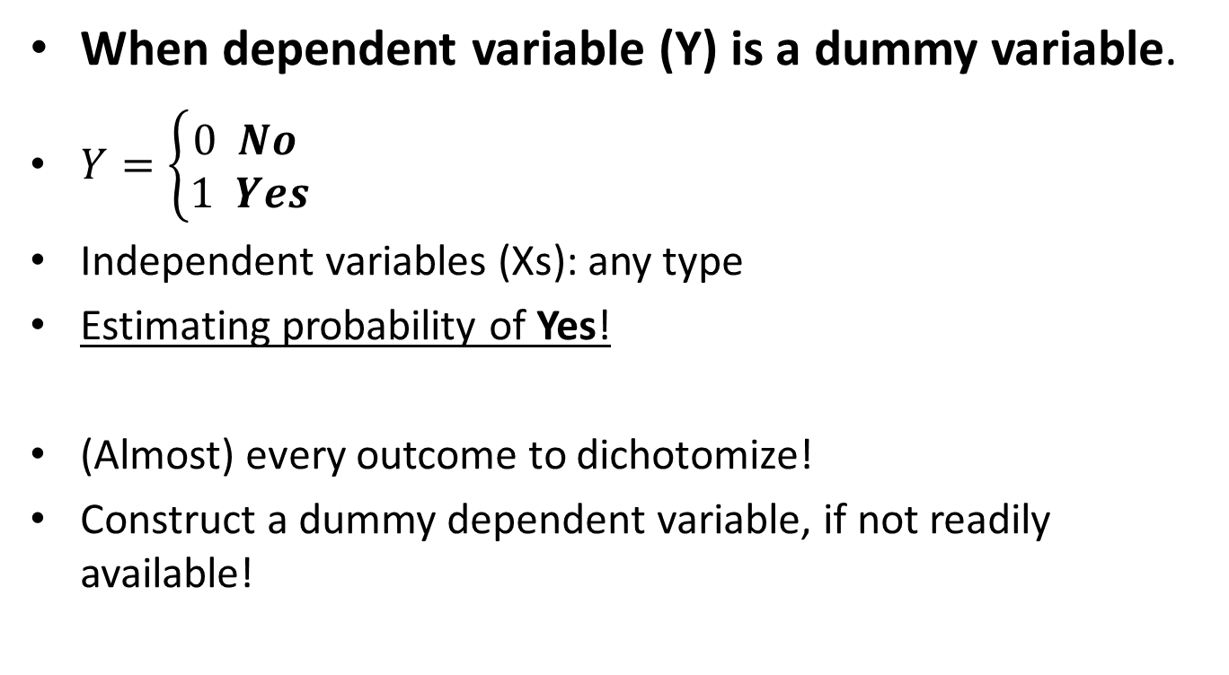
Logit (Logistic) regression
When dependent variable (Y) is a dummy variable.
$Y=\left\{\begin{aligned}0 No \\ 1 Yes\end{aligned}\right.$
Independent variables (Xs): any type
Estimating probability of Yes!
(Almost) every outcome to dichotomize!
Construct a dummy dependent variable, if not readily available!

Slide 4

Example: RQ: are high income households more likely homeowners?
Y : The probability of home ownership (original: huko)
$Y=\left\{\begin{aligned}0 Tenant \\ 1 Owner\end{aligned}\right.$
Observed probability of homeownership: 36%

Slide 5
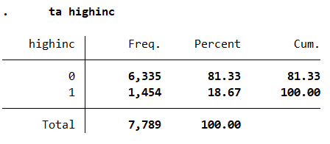

Ex 1. Logit model with a dummy explanatory variable: coefficients
$${Log(Odds)}_{i} =α+βX_{i}+ε_{i}$$
General: High-income households are more likely homeowners than low-income HHs (because the coeff is significant and positive).
Precise: the log odds of a high income HH owning home is 1.83 higher than that of a low-income HH.
highinc =1 if (income>50 000 Euro), 0 otherwise

Slide 6
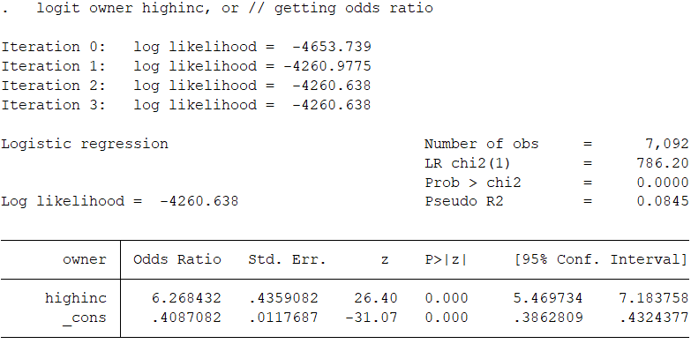

Ex 1. Logit model with a dummy explanatory variable: Odds Ratio
General: High-income households are more likely homeowners than low-income HHs (because the coeff is significant and positive).
Precise: the odds of a high income HH owning home is 6.26 times higher than that of a low-income HH.
$${Odds}_{i} =α+βX_{i}+ε_{i}$$

Slide 7
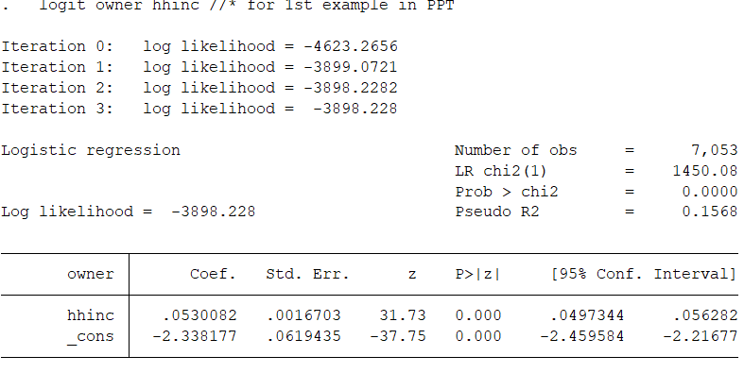
Exp 2. Logit model with continues hh-income
General: High income households are more likely homeowners.
Precise: for a one-unit increase in household income, the expected change in log odds of owning home is 0.053

Slide 8
Logit model for Owner vs TENANT (with continues income)
General: High income households are LESS likely TENANTS.
Precise: for a one-unit increase in household income, the expected change in log odds of being tenant is -0.053

Slide 9
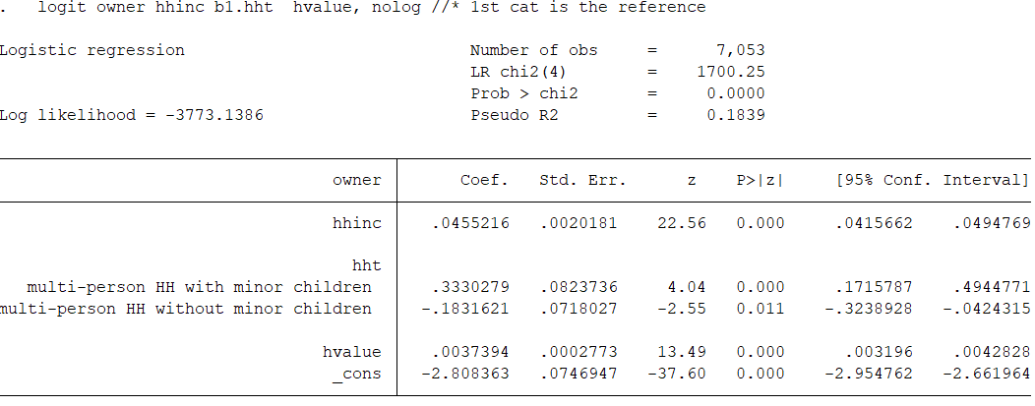
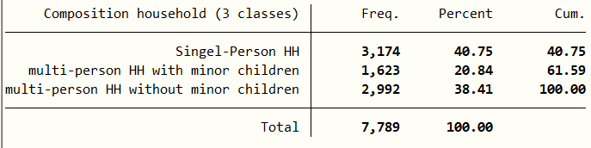
Ex 3. A multivariate logit model
General: HH-income increases the probability of homeownership, holding household composition and the value of property (because the coeff is significant and positive).
Precise: one unit (thousand Euro) increase in HH income is associated with 0.045 increase in the log odds of homeownership, given the household composition and the value of property.

Slide 10
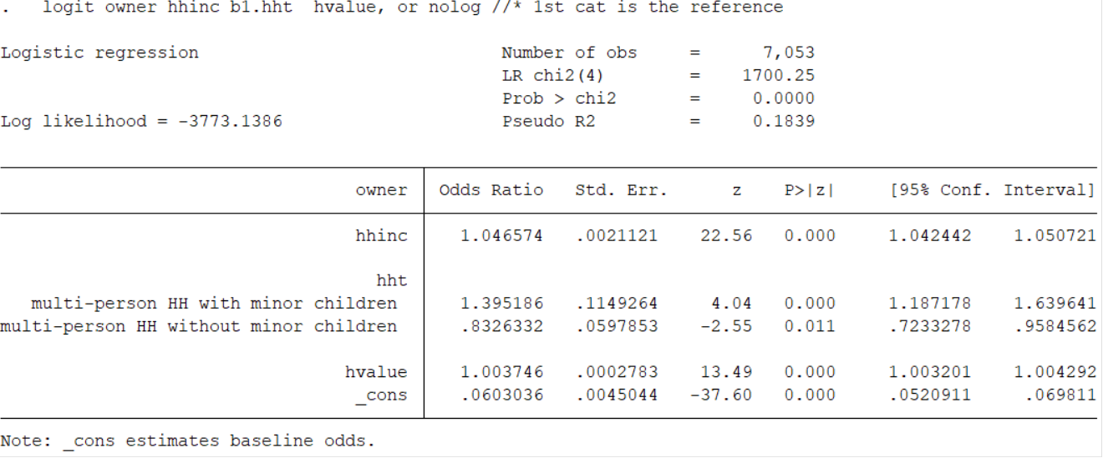
Ex 3. A multivariate logit model
General: HH-income increases the probability of homeownership, holding household composition and the value of property (because the coeff is significant and positive).
Precise: one unit (thousand Euro) increase in HH income is associated with a 4.5 % increase in the odds of homeownership, given the household composition and the value of property.

Slide 11

Some theory odds ratio and probability
$Odds=\frac{Pr⁡(owner)}{Pr⁡(rent)}$
Odds: $\frac{0.8}{0.2}$; $\frac{0.6}{0.4}$; $\frac{0.5}{0.5}$; $\frac{0.2}{0.8}$
Be careful: $Odds≠prob$

Slide 12
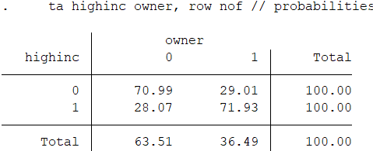
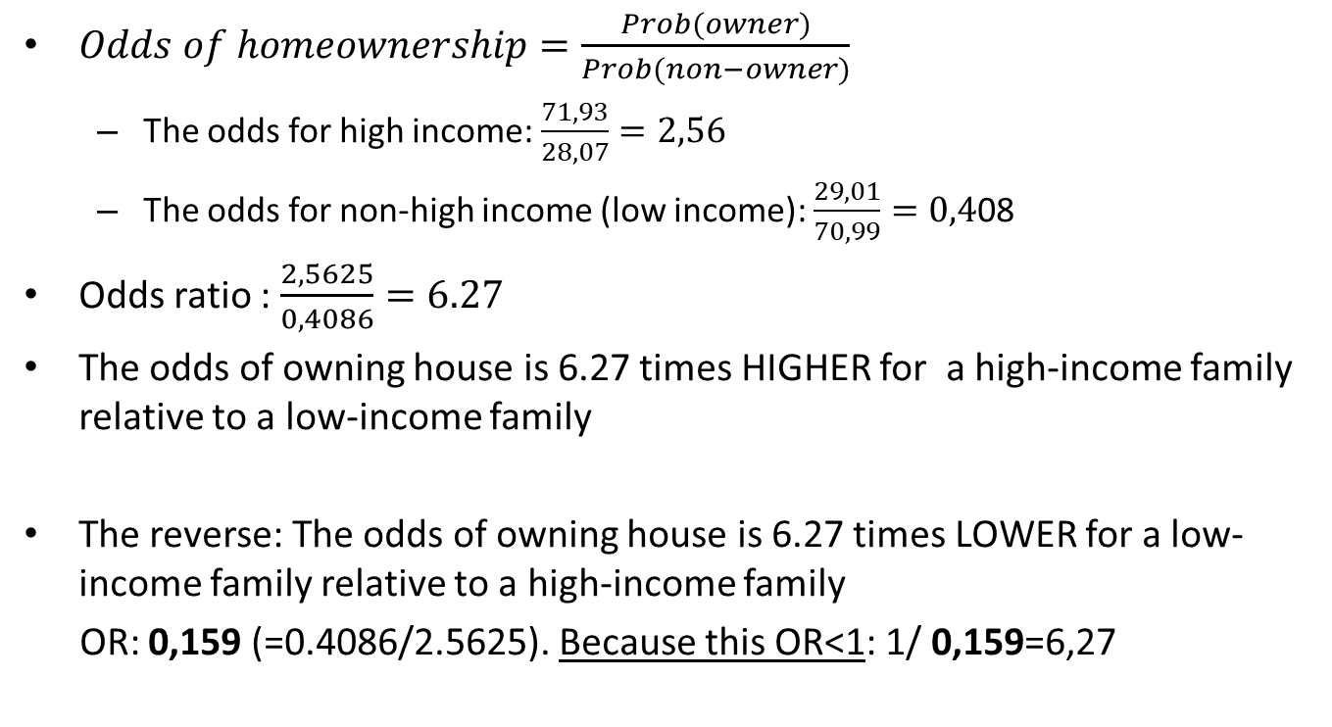
Odds and Odds Ratio
$Odds of homeownership=\frac{Prob(owner)}{Prob(non−owner)}$
The odds for high income: $\frac{71,93}{28,07}=2,56$
The odds for non-high income (low income): $\frac{29,01}{70,99}=0,4$08
Odds ratio : $\frac{2,5625}{0,4086}=6.27$
The odds of owning house is 6.27 times HIGHER for a high-income family relative to a low-income family
The reverse: The odds of owning house is 6.27 times LOWER for a low-income family relative to a high-income family
OR: 0,159 (=0.4086/2.5625). Because this OR<1: 1/ 0,159=6,27

Slide 13
Coefficient or Odds ratio
Coefficient > 0 (or OddsR > 1): positive association
Coefficient = 0 (or OddsR = 1): no association
Coefficient < 0 (or 0<OddsR < 1): negative association

Slide 14
Ranges of OR
BE AWARE when interpreting OR
Positive association: 1< OddsRatio <∞
in practice: 1< OddsR < 40
Coefficient > 0
Negative association 0<OddsRatio < 1 Coefficient < 0

Slide 15
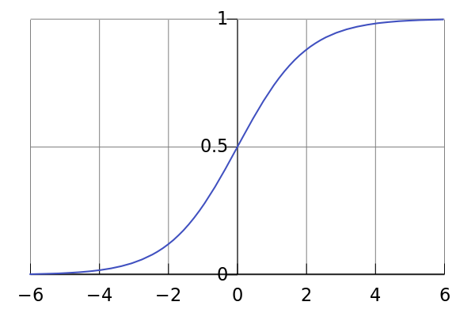

Logistic function
$$Pr\left(Y_{i}=1 | x_{i}\right)=\frac{e^{βx_{i}^{}}}{1+e^{βx_{i}^{}}}=\frac{1}{1+e^{−βx_{i}^{}}}$$

Slide 16
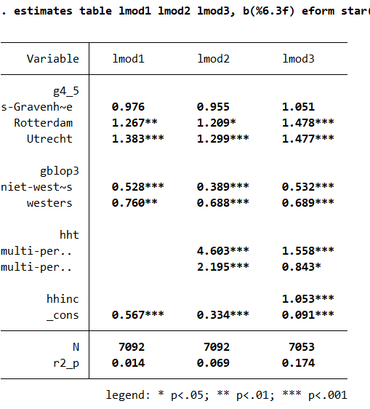
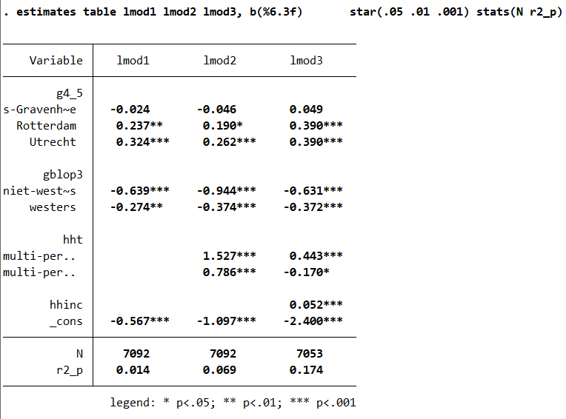
Exercises 3. A logit regression model: step wise modelling

Slide 17
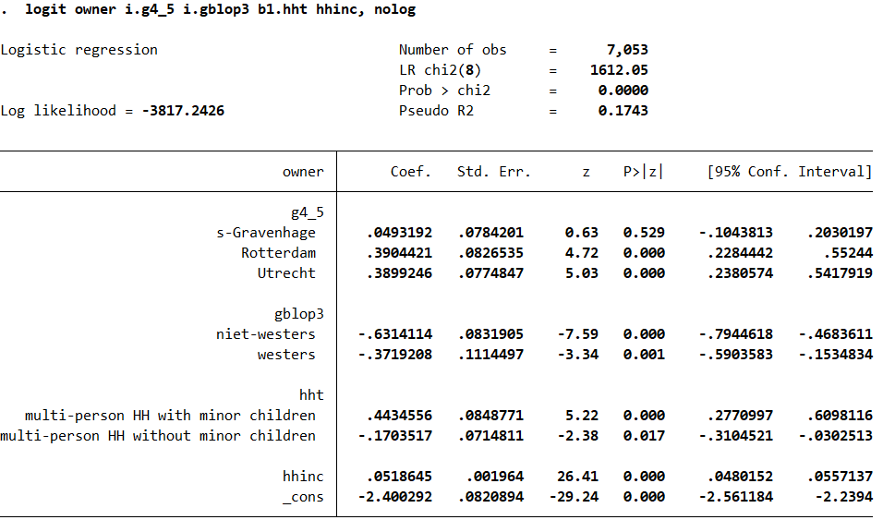
Exercises 3. A logit regression model
the homeownership probability is significantly higher in Rotterdam and Utrecht compared to Amsterdam but no-significant difference between the Hague and Amsterdam, holding other variables constant.
Household with migrant background are less likely homeowners. Etc……

Slide 18
Next lecture
Alternative using opportunities of variables
Categorization
Quadratic function
Logarithmic transformation
Presenting results
Coefficients versus odds ratios
Marginal effects versus probabilities
Plotting results

